Slide 1
WineReview
Lacey Field

Slide 2
Client Problem
Goal is to review various trends such as descriptions and price/ points as well as trends between price and points
Useful to wine sellers to boost sales - can change their stocks based on higher points/ price
How is this data useful?

Slide 3
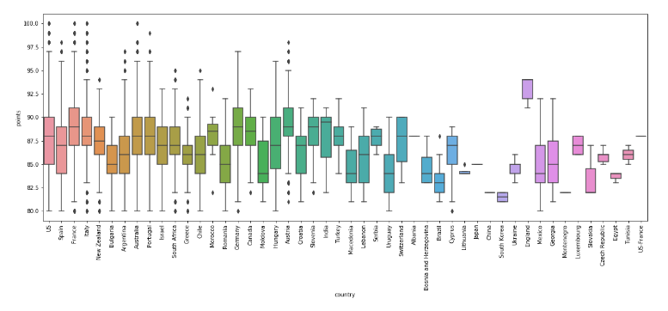
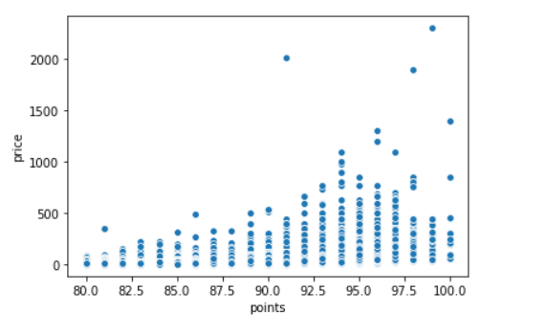
WineReview Data
Sourced from WineEnthusiast via Kaggle
Contained over 130K wines
Data fairly clean but performed wrangling
Dropped unnecessary columns
Treated/ removed NAN values
Observed outliers and removed as needed
EDA on data
Graphed top countries and wine varieties
Ranges of prices/ points, varieties
Point ranges by country
Compared price and prints to see correlation

Slide 4
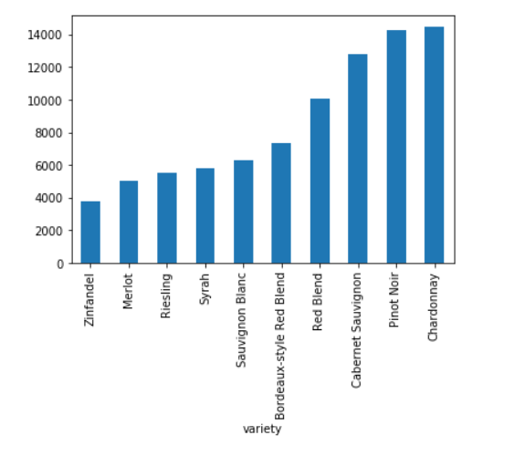
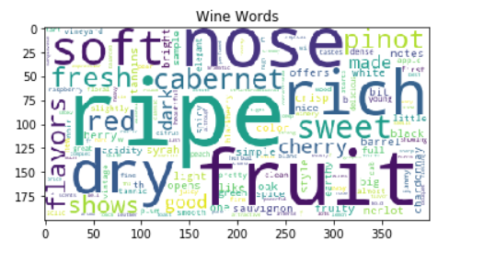
Bag of words
Used Word Tokenize to split the description column into words and remove stop words
Used Counter to create a list of top words
Used word cloud to visualize these top words
Repeated steps for top wine varieties to see differences with descriptions

Slide 5
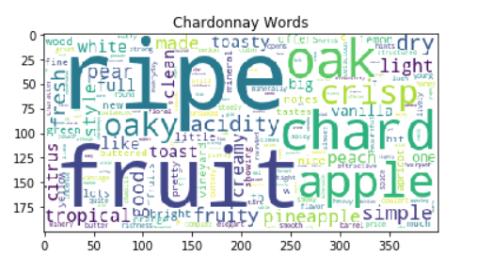
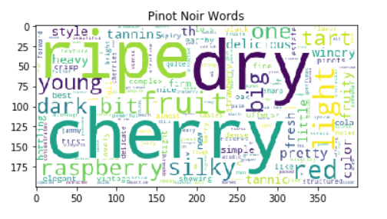
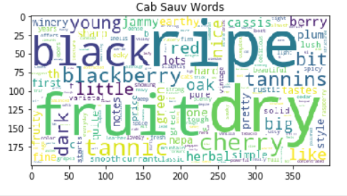
Words Split by Variety

Slide 6
Word Preprocessing
Used stemming and lemmatization on tokens to clean data
Used RegexpTokenizer and lambda functions to create a column of stemmed word tokens to be used for modeling during ML section

Slide 7
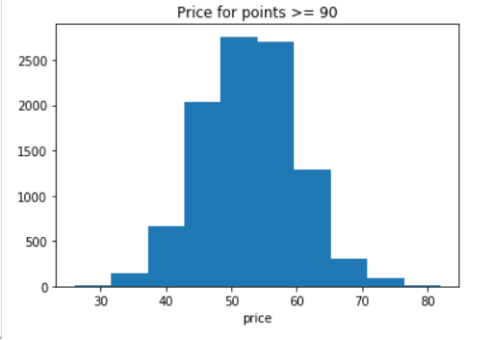
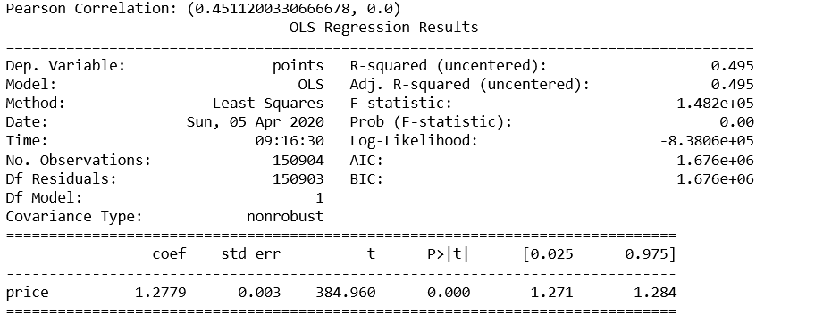
Inferential Statistics
Calculated covariance between price and points - showed moderately correlated
Ran linregress on points and price for summary stats - saw r-value was 0.4511
Also calculated pearson and spearman coefficient and saw moderately strong results at 0.45 and 0.58

Slide 8
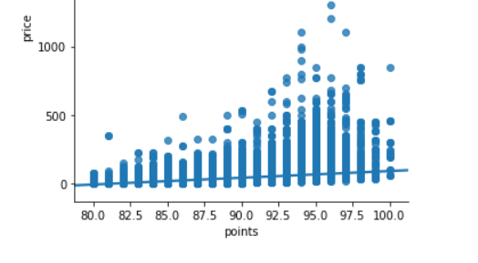
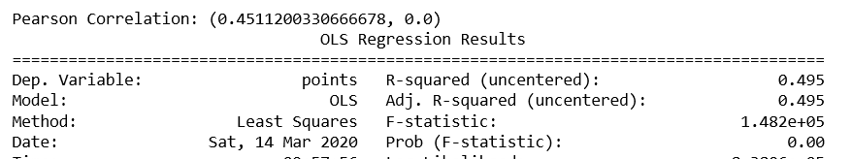
ANOVA Testing
Performed a series of ANOVA testing for different variables to compare R**2 and p values. Variables tested:
Price and Variety
Points and Province
Points and Variety
Price and Points
Saw that most variables hovered around R**2 of 0.10 with p-value of 0.00
Price and points had strongest R**2 with 0.495

Slide 9
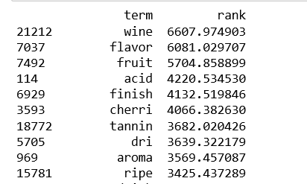
TF-IDF Model
Wanted to use TF-IDF to create a more enhanced bag of words
Used TF-IDF vectorizer on cleaned description column and transformed data
Enumerated over matrix of tokens and TF-IDF rating to assign the term with the rank
Sorted this list to obtain top words based on TF-IDF rank
Can see top words are more descriptive with fruit, finish, cherri, tannin making the top ten

Slide 10

ML Modeling NB
Train, test split with Multinomial NB
Used countvectorizer on wine description and split into training and test data
Wine variety and description yielded 0.534 accuracy
Wine variety and description cleaned with pre-processing yielded 0.5399 accuracy
Other factors compared with this model:
Points and description cleaned yielded 0.284 accuracy
Points and count yielded 0.139
Points and province yielded 0.148
Strongest relationship is between variety and description

Slide 11
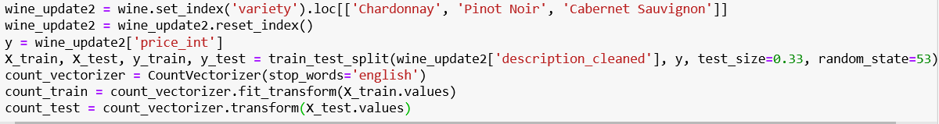
ML Modeling NB Cont.
Used same model to compare to compare variables against price
Price and description yielded .162 accuracy
Removed price outliers and focused on top threes wines, accuracy improved to .185
Price and country yielded .07 accuracy
Price and province yielded accuracy .10

Slide 12
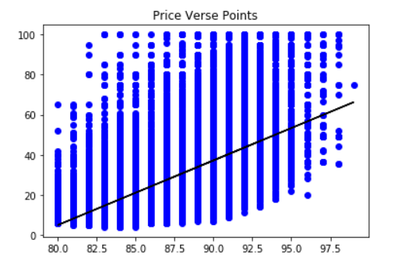
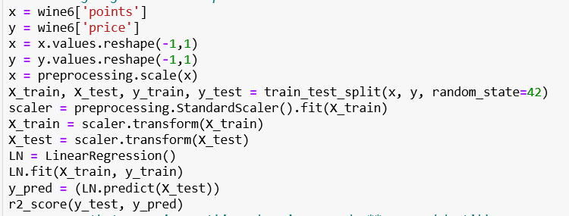
Linear Regression
Since points and price had a strong pearson coefficient, modeled with linear regression
Used scaling and preprocessing on data and modeled with linear regression. Yielded accuracy score of 0.197
Removed price outliers over 500 and modeled, yielded score of .295

Slide 13
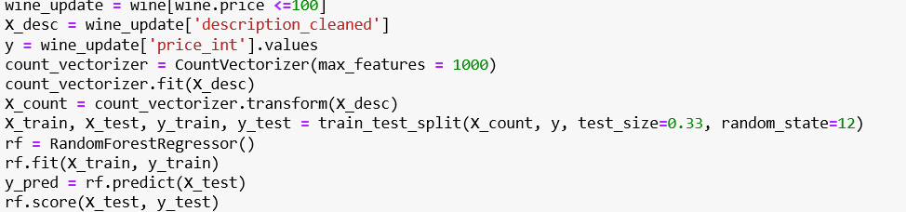
ML Modeling RF
Used RandomForestRegressor with CountVectorizer on points and description - accuracy score was .70
Also compared price and description with RF model, accuracy score was 0.30
Used RF model with TF-IDFVectorizer with points and price against description
Points and description had score of .707
Price and description had score of .296
Removed price outliers and modeled improved to .547

Slide 14
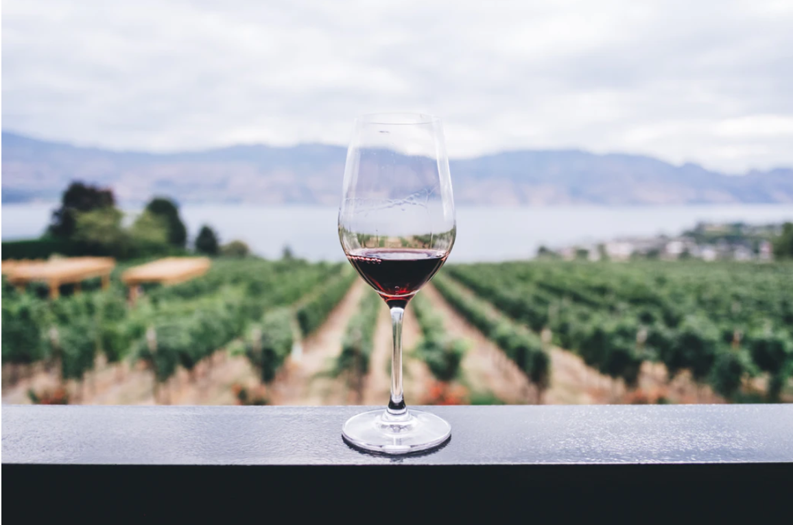
ML Takeaways
Fairly strong relationship with points and description/price - would recommend stocking higher point wines to boost sales/ satisfaction
Words for the top three wine varieties are most descriptive and specific and would recommend using those lists if focus is on description

Slide 15
Top Trends
Top trends noted during modeling with score:
price/points: 0.30
variety/ description: 0.54
points/ description: 0.71
price/ description: 0.55

Slide 16
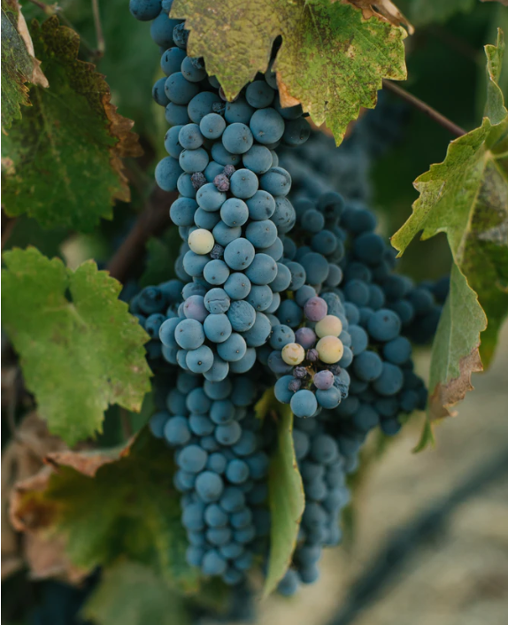
Recommendations/ Follow-ups
Would be more insightful to have actual reviews from customers of wine types
Could perform sentiment analysis to obtain words that have positive customer responses
This would also help to have an understanding of what varieties and types are being sold more often to improve the models

Slide 17
Summary
Data Wrangling
Removed outliers/unnecessary data and treated Nan values. Looked at beginning trends such as points and prices ranges. Created a bag of words for top wine varieties to compare words for trends
EDA
Explored data via Anova testing/ Pearson correlations/ Poisson distributions and noticed moderate relationship between price and points
Machine Learning
Modeled numerous features against price and points such as description and country using NB. Also modeled using RF and saw large improvement in model score. Price and points modeled very well against description. Used the TF-IDF model to create more enhanced bag of words but found wine varietal specific bags were most useful

